Slide 1
Distributed Algorithms

Slide 2
B.Tech. IV (CO) Semester - 8 | L | T | P | C
CO402 : DISTRIBUTED ALGORITHMS | 3 | 1 | 2 | 5
COURSE OBJECTIVES
To expose students to both the abstraction and details of file systems. To provide students with contemporary knowledge in parallel and distributed computing. To focus on performance and flexibility issues related to systems design decisions. Introduce a variety of methodologies and approaches for reasoning about concurrent and distributed programs
COURSE OUTCOMES
After successful completion of this course, student will be able toUnderstand the concepts and issues related to distributed systems. Design and develop the programs for distributed environment. Manage performance, reliability and other issues while designing in distributed environment.
COURSE CONTENT
INTRODUCTION TO DISTRIBUTED SYSTEMS | (04 Hours)
Review of Networks, Operating Systems – Concurrent Programming - Characteristics & Properties of DSs – Taxonomy - Design goals – Transparency Issues
DISTRIBUTED COMPUTING PARADIGMS | (02 Hours)
Basic Message Passing Model – The Client Server, Message Passing, Remote Procedure Call Model – RPC in conventional languages and in Java - The Distributed Objects – The Collaborative Application
INTER-PROCESS COMMUNICATION MECHANISMS | (08 Hours)
Communication in Distributed Systems, Socket Programming -Client Server examples, I/O Multiplexing, Inetd Super Server – Secure Sockets – The SSL & the Java Secure Socket Extension
PROCESS MODELS IN DISTRIBUTED SYSTEMS | (08 Hours)
Processes, Threads - Code Migration; Software Agents – CSP Distributed Processes - Naming with Mobile Entities - Unreferenced Objects
SYNCHRONIZATION | (04 Hours)
Clock Synchronization – Logical clocks – Election Algorithms – Distributed Mutual Exclusion
CONSISTENCY AND REPLICATION | (04 Hours)
Motivation, Object Replication, Consistency Models, Distribution Protocols – Consistency Protocols
FAULT TOLERANCE | (04 Hours)
Failure Models – Process Resilience – Reliable Client Server and Group Communications – Distributed Commit Protocols – Check-pointing and Recovery - Distributed Databases - Distributed Transactions
DISTRIBUTED FILE SYSTEMS | (04 Hours)
SUN NFS – Naming issues in DFS – Examples of contemporary DFSes – Comparisons
MISCELLANEOUS TOPICS | (04 Hours)
Distributed Object-based Systems – COM – CORBA – Architecture and Programming – Distributed Coordination based systems – TIB/RENDEZVOUS - JINI
Tutorials will be based on the coverage of the above topics separately and relevant research papers prescribed in the class | (14 Hours)
(Total Contact Time: 42 Hours + 14 Hours = 56 Hours)
PRACTICALS
Implementation of the distributed applications/miniprojects using the TCP/IP Socket API as specified in the class e.g. a typical WWW server, a distributed Readers-Writers problem etc. Implementation of the distributed applications/ miniprojects using the SUN ONC RPC Model, JAVA RMI, any Java-CORBA ORBas specified in the class
BOOKS RECOMMENDED
A S Tanenbaum, Martin Steen,"Distributed Systems: Principles and Paradigms", 2/E,PHI, 2006 Nancy A. Lynch, "Distributed Algorithms", Morgan Kaufmann, 1996 W Richard Stevens, "Unix Network Programming: Vol 1, Networking APIS: Sockets & XTI",2/E, Pearson Education,1998 Colouris,Dollimore,Kindberg, "Distributed Systems Concepts & Design", 4/E,Pearson Ed. 2005 MukeshSinghal, Niranjan G. Shivaratri, "Advanced concepts in operating systems: distributed, database, and multiprocessor operating systems", MGH, 1/E, 1994.

Slide 3
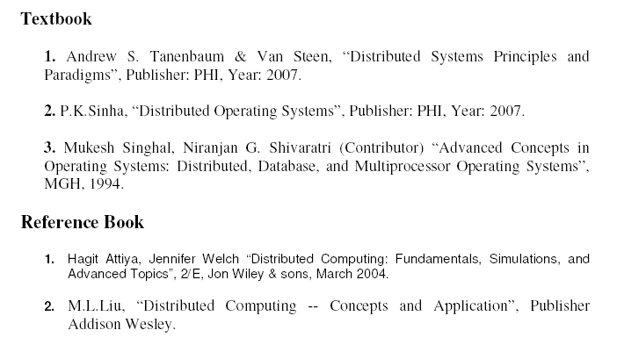
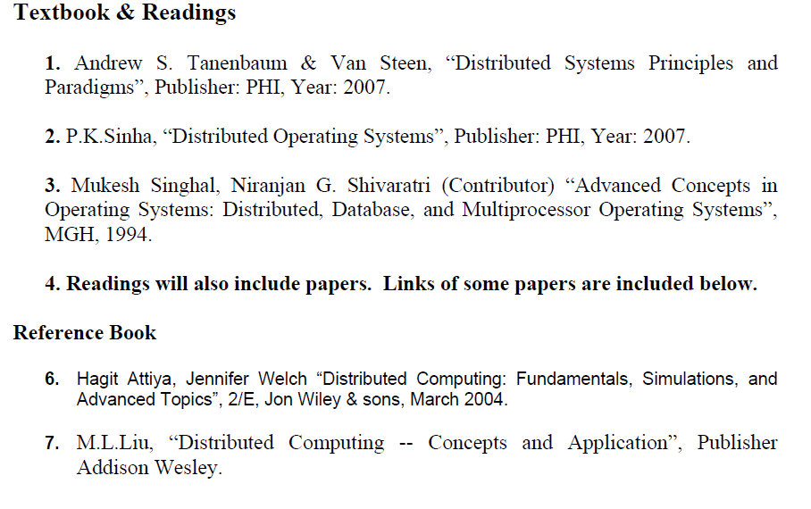
Textbook & Readings

Slide 4
Assignments:
This course will involve listening to lectures, reading papers, writing reviews of papers, participating in class discussions, presenting papers and leading class discussions.
Students will be required to write reviews for paper they read.
Definitions:

Slide 5
Distributed System
Distributed Systems - what and why?
Architecture
Challenges
Overview - principles and paradigms

Slide 6
Distributed system, distributed computing
Early computing was performed on a single processor. Uni-processor computing can be called centralized computing.
A distributed system is a collection of independent computers, interconnected via a network, capable of collaborating on a task.
Distributed computing is computing performed in a distributed system.

Slide 7
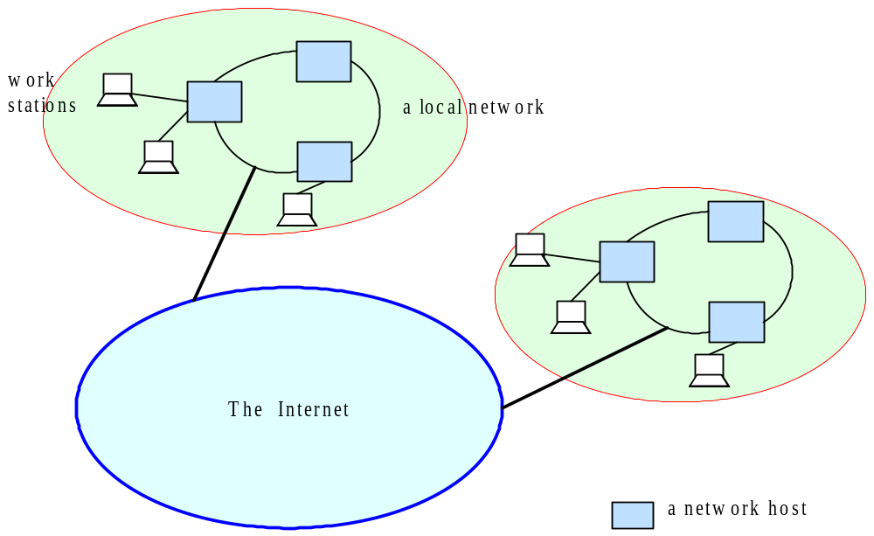
Distributed Systems

Slide 8
DISTRIBUTED SYSTEMS
What is a distributed system?
  Andrew Tannenbaum deﬁnes it as follows:
  “A distributed system is a collection of independent computers that appear to its users as a single coherent system.”
  Is there any such system?
  We will learn about the challenges in building “true” distributed systems
  “A distributed system is a collection of independent computers that are used jointly to perform a single task or to provide a single service.”

Slide 9
Why Distributed?
Resource and Data Sharing
  Printers, databases, multimedia servers etc.
Availability, Reliability
  The loss of some instances can be hidden
Scalability, Extensibility
  System grows with demands (e.g. extra servers)
Performance
  Huge power (CPU, memory etc.) available
  Horizontal distribution (same logical level is distr.)
Inherent distribution, communication
  Organizational distribution, e-mail, video conference
  Vertical distribution (corresponding to org. struct.)

Slide 10
Parallel Computing vs Distributed Computing
Parallel computing is more tightly coupled to multi-threading, or how to make full use of a single CPU.
Distributed computing refers to the notion of divide and conquer, executing sub-tasks on different machines and then merging the results.
However, since we stepped into the Big Data era, it seems the distinction is indeed, and most systems today use a combination of parallel and distributed computing.
An example - Hadoop with the Map/Reduce paradigm, a clearly distributed system with workers executing tasks on different machines, but also taking full advantage of each machine with some parallel computing.

Slide 11
Problems of Distribution
Concurrency, Security
  Clients must not disturb each other
Partial failure
  We often do not know, where is the error (e.g. RPC)
Location, Migration, Replication
  Clients must be able to find their servers
Heterogeneity
  Hardware, platforms, languages, management
Convergence
  Between distributed systems and telecommunication

Slide 12
Examples of distributed systems
Network of workstations (NOW): a group of networked personal workstations connected to one or more server machines.
The Internet
An intranet: a network of computers and workstations within an organization, separated from the Internet via a protective device (a firewall).
A large-scale distributed system – eBay
Collection of Web servers: distributed database of hypertext and multimedia documents.
Distributed file system on a LAN
Domain Name Service (DNS)
small-scale distributed system
-Home Smart

Slide 13
Computers in a Distributed System
Workstations: computers used by end-users to perform computing
Server machines: computers which provide resources and services
Personal Assistance Devices: handheld computers connected to the system via a wireless communication link.

Slide 14
THE ADVANTAGES OF DISTRIBUTED SYSTEMS
What are economic and technical reasons for having distributed systems?
Economics:
Performance: By using the combined processing and storage capacity of many nodes, performance levels can be reached that is out of the scope of centralized machines.
Scalability: Resources such as processing and storage capacity can be increased incrementally.
Inherent distribution: Some applications, such as email and the Web (where users are spread out over the whole world), are naturally distributed. This includes cases where users are geographically dispersed as well as when single resources (e.g., printers, data) need to be shared.
Reliability: By having redundant components, the impact of hardware and software faults on users can be reduced.
Better flexibility in meeting users’ needs.

Slide 15
THE DISADVANTAGES OF DISTRIBUTED SYSTEMS
Multiple Points of Failures: the failure of one or more participating computers, or one or more network links, can bring trouble.
Security Concerns: In a distributed system, there are more opportunities for unauthorized attack.
Software complexity: Distributed software is more complex and harder to develop than conventional software.
Distributed systems are hard to build and understand.

Slide 16
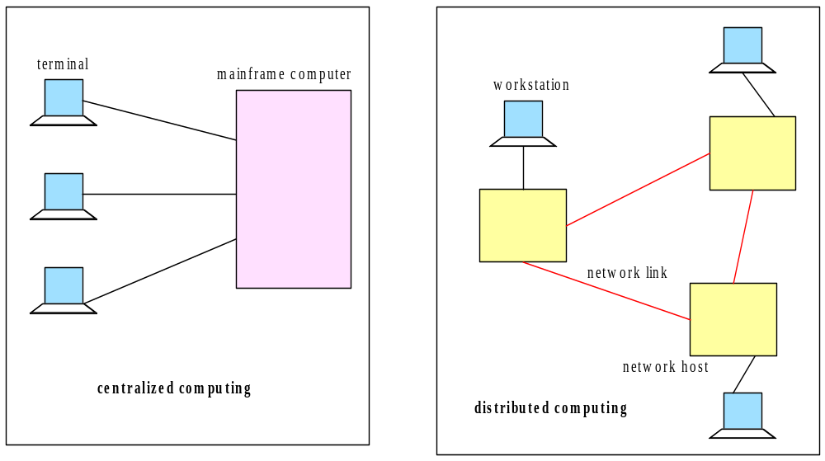
Centralized vs. Distributed Computing

Slide 17
DISTRIBUTED SYSTEM ARCHITECTURE
Hardware Architecture: Software Architecture:
§ Uniprocessor §Uniprocessor OS
§ Multiprocessor §Multiprocessor OS
§ Multicomputer §Network OS (NOS)
§ Distributed OS (DOS)
§ Middleware
A key characteristic of distributed systems that includes
  a hardware aspect (independent computers)
  and a software aspect (performing a task and providing a service)

Slide 18

HARDWARE ARCHITECTURE
Uniprocessor:
Properties:
Single processor
Direct memory access

Slide 19
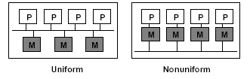
Continued……
Multiprocessor: those that have shared memory , usually called multiprocessors, and those do not , sometimes called Multicomputers.
Typically, there are 2 major types of Parallel Architectures that are common in the industry: Shared Memory Architecture and Distributed Memory Architecture. Shared Memory Architecture, again, is of 2 types: Uniform Memory Access (UMA), and Non-Uniform Memory Access (NUMA).
Properties:
Multiple processors
Direct memory access
Uniform memory access -access time to a memory location is independent of which processor makes the request
Non-uniform memory access- the memory access time depends on the memory location relative to a processor.

Slide 20
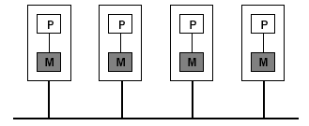
Continued……
Multicomputer:
Properties:
Multiple computers
Network Connection (to support higher bandwidth)
Homogeneous (all nodes support same physical architecture) vs. Heterogeneous (does not support same physical architecture)

Slide 21
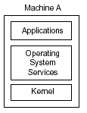
SOFTWARE ARCHITECTURE
Uniprocessor OS:

Slide 22
Continued….
Multiprocessor OS:
Similar to a uniprocessor OS but:
Kernel designed to handle multiple CPUs
Communication uses same primitives as uniprocessor OS
Tightly-coupled software on tightly-coupled hardware
Examples: high-performance servers
shared memory
single run queue

Slide 23
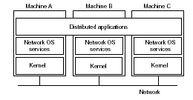
Continued….
Network OS:
Properties:
No single system image (Users are aware of multiplicity of machines)
Individual nodes are highly autonomous
Access to resources of various machines is done explicitly by:
  Remote logging into the appropriate remote machine (telnet )
  Transferring data from remote machines to local machines, via the File Transfer Protocol (FTP) mechanism
Examples: Linux, Windows

Slide 24
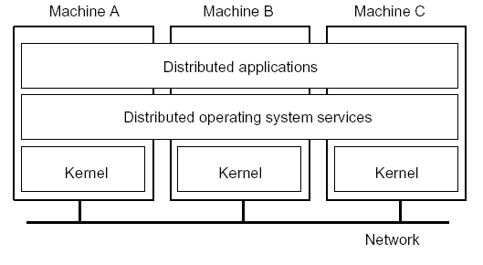
Continued….
Distributed OS: A tightlycoupled operating system is generally referred to as a distributed operating system (DOS), and is used for managing multiprocessors and homogeneous multicomputers.
Properties:
Users not aware of multiplicity of machines
    Access to remote resources similar to access to local resources
High degree of transparency (single system image)
Support distributed services (services may include distributed shared memory, assignment of tasks to processors, distributed storage, interprocess communication, transparent sharing of resources, distributed resource management, etc.
Homogeneous hardware

Slide 25
Middleware
Neither a distributed operating system or a network operating system really qualifies as a distributed system according to the definition.
Distributed operating system is not intended to handle a collection of independent computers, while a network operating system does not provide a view of a single coherent system.
The question comes to mind whether it is possible to develop a distributed system that has the best of both words: the scalability and openness of network operating systems and the transparency and related ease of use of distributed operating systems.
The solution is to be found in an additional layer of software that is used in network operating systems to more or less hide the heterogeneity of the collection of underlying platforms but also to improve distribution transparency.
Many modern distributed systems are constructed by means of such an additional layer of what is called middleware.

Slide 26
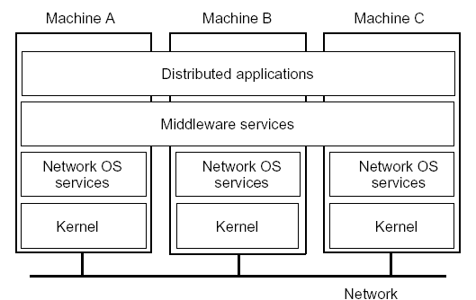
Continued….
  Middleware: Middleware enables the components to coordinate their activities.
Properties:
System independent interface for distributed programming
Improves transparency (e.g., hides heterogeneity)
Provides services (e.g., naming service, transactions, etc.)
Provides programming model (e.g., distributed objects)

Slide 27
Continued….
Why is Middleware ‘Winning’?:
1. Builds on commonly available abstractions of network OS
2. Examples: RPC, NFS, CORBA
3. Usually runs in user space
5. less error
6. Independence from OS, network protocol, programming language, etc.

Slide 28
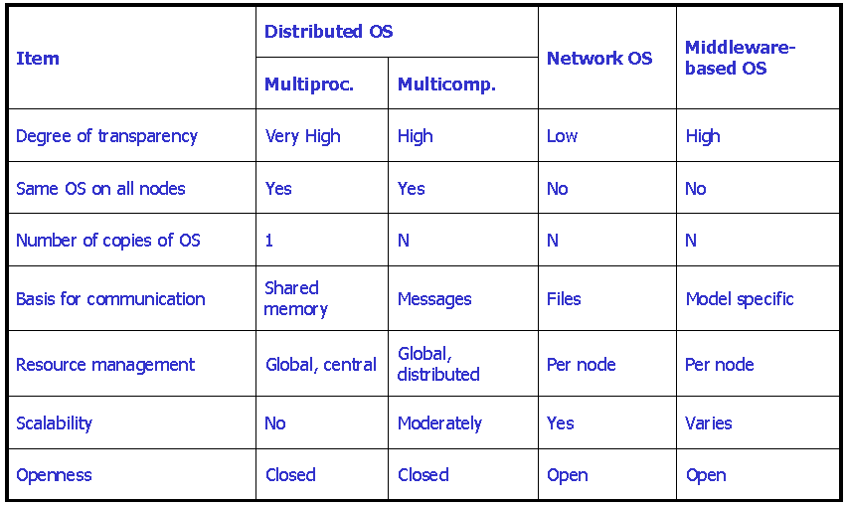
Comparison between Systems

Slide 29
Software Concepts
System | Description | Main Goal
DOS | Tightly-coupled operating system for multi-processors and homogeneous multicomputers | Hide and manage hardware resources
NOS | Loosely-coupled operating system for heterogeneous multicomputers (LAN and WAN) | Offer local services to remote clients
Middleware | Additional layer at top of NOS implementing general-purpose services | Provide distribution transparency

Slide 30
Openness
An open distributed system is a system that offers services according to standard rules that describe syntax and semantics of the services.
  Systems should conform to well-defined Interfaces
  System should support Interoperability
  Components of different origin can communicate
  System should support Portability
  Components work on different platforms
  Standards – a necessity

Slide 31
DISTRIBUTED SYSTEMS IN CONTEXT
Networking:
Network Protocols, routing protocols, etc.
Distributed Systems: make use of networks
Operating Systems:
Resource management for single systems
Distributed Systems: management of distributed resources

Slide 32
BASIC PROBLEMS AND CHALLENGES IN DISTRIBUTED SYSTEMS
The distributed nature of a systems gives rise of the following challenges:
    Transparency
    Scalability
    Dependability
    Performance
    Flexibility

Slide 33
TRANSPARENCY
Concealment of the separation of the components of a distributed system (single image view).
There are a number of forms of transparency:
Access: Local and remote resources accessed in same way
  the users should not need or able to recognize whether a resource (hardware or software) is remote or local.
  This is facilitated by distributed operating system.
Location: Users unaware of location of resources
Migration: Resources can migrate without name change
Replication: Users unaware of existence of multiple copies
Failure: Users unaware of the failure of individual components
Concurrency: Users unaware of sharing resources with others

Slide 34
SCALABILITY
A system is said to be scalable if it can handle the addition of users and resources without suffering a noticeable loss of performance or increase in administrative complexity
Scale has three dimensions:
Size: number of users and resources (problem: overloading)
Geography: distance between users and resources (problem:
communication)
Administration: number of organizations that apply administrative
control over parts of the system (problem: administrative mess)
Note:
Scalability often conflicts with (small system) performance

Slide 35
DEPENDABILITY
Dependability of distributed systems is a double-edged sword:
  Distributed systems promise higher availability:
-Replication
  But availability may degrade:
-More potential points of failure
Dependability requires consistency, security, and fault tolerance

Slide 36
PERFORMANCE
Any system should strive for maximum performance
In distributed systems, performance directly conﬂicts with some other desirable properties….
Transparency
Security
Dependability
Scalability

Slide 37
FLEXIBILITY
“A flexible distributed system can be configured to provide exactly the services that a user or programmer needs”
Flexibility generally provides a number of key properties:
Extensibility: Components/services can be changed or added
Openness of interfaces and speciﬁction
Interoperability

Slide 38
PRINCIPLES
There are several key principles underlying all distributed systems. As such, any distributed system can be described based on how those principles apply to that system.
• System Architecture
• Communication
• Synchronization
• Replication and Consistency
• Fault Tolerance
• Security
• Naming
During the rest of the course we will examine each of these principles in detail.

Slide 39
PARADIGMS
Most distributed systems are built based on a particular paradigm (or model)
Shared memory
Distributed objects
Distributed file system
Shared documents
Distributed coordination
Agents
This course will cover the first three in detail.

Slide 40
MISCELLANEOUS “RULES OF THUMB”
Here we present some rules of thumb that are relevant to the study and design of distributed systems
Trade-offs - Many of the challenges provide conflicting requirements. For example better scalability can cause worse overall performance. Have to make trade-offs - what is more important?
Separation of Concerns- Split a problem into individual concerns and address each separately
End-to-End Argument- Some communication functions can only be reliably implemented at the application level
Mechanism -A system should build mechanisms that allow flexible application of policies.
Keep It Simple- make things as simple as possible, but no simpler.

Slide 41
OVERVIEW OF COURSE
Introduction
System Architecture and Communication
Replication and Consistency and Distributed Shared Memory
Middleware and Distributed Objects
Synchronization and Coordination
Fault Tolerance
Security
Naming
Distributed File Systems
Extras:
  Some reading materials
  Research papers

Slide 42
Location Transparency: The name of a file does not give any hint of file's physical storage location.
Location Independence: The name of a file does not need to be changed when file's physical storage location changes.

Slide 43
MapReduce
A MapReduce job usually splits the input data-set into independent chunks which are processed by the map tasks in a completely parallel manner. The framework sorts the outputs of the maps, which are then input to the reduce tasks. Typically both the input and the output of the job are stored in a file-system.
Word Count - Hadoop Map Reduce Example
  Word count is a typical example where Hadoop map reduce developers start their hands on with.
  This sample map reduce is intended to count the no of occurrences of each word in the provided input files.
What are the minimum requirements?
  Input text files – any text file
  The modern platform for data management and analytics
  The mapper, reducer and driver classes to process the input files

Slide 44
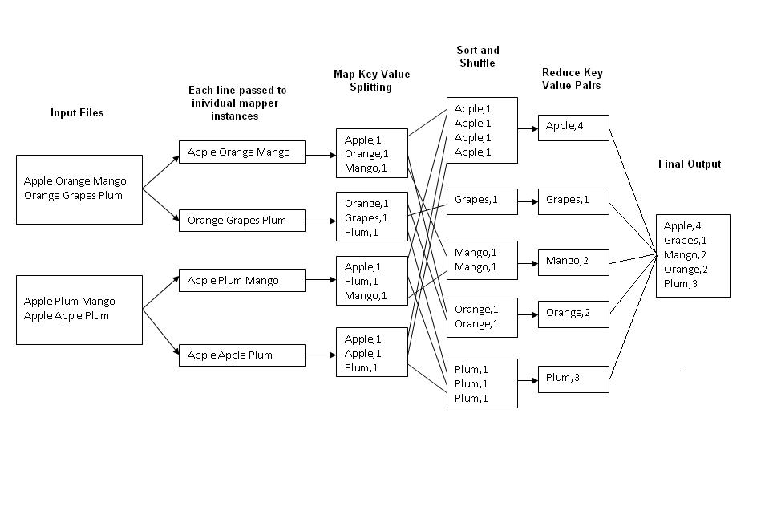

Word Count - Hadoop Map Reduce Example

Slide 45
Integration
Combining software or hardware components or both into an overall system.
Portability
Relating to or being software that can run on two or more kinds of computers or with two or more kinds of operating systems.
Interoperability
The ability of software and hardware on multiple machines from multiple vendors to communicate.

